Slide 1
BUILDING WEB APPLICATIONS WITH REACT
Introduction to ReactTS

Slide 2
Objectives
In this course, you will
Strengthen your understanding of HTML, CSS, and TypeScript fundamentals
Develop the ability to write React code
Apply problem-solving skills to build a single-page application using React

Slide 3
GETTING THE MOST FROM THIS MODULE
You should
Be prepared to get hands-on
Not expect to get everything right the first time
Bring your problem-solving skills
Don’t hesitate to ask and answer questions
Take breaks – they’re important!

Slide 4
MODULE OVERVIEW
Strengthen your web skills (with exercises)
React overview
Explore React concepts (with exercises)
Hands-on project – build a web app yourself
Throughout the module, you’ll be given time to progress through the hands-on project at your own pace.

Slide 5
Installing React

Slide 6
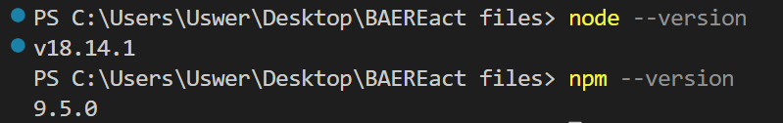
Built on Node
ReactTS is predictably built using node, although as you will see, there are many ways we can extend React from it’s base install.
Check that you have both node and npm installed. In a terminal in VSCode, type:
node --version
And then
npm --version
Notes:
npm = node packet manager and it is how we download and manage all packages that we can use in node.
Following the work done with javascript, this should be installed, but it is always good practice to check the version you are using and update if necessary

Slide 7

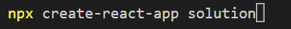


Traditional method of Installing React
React is very easy to install in VSCode just a few short commands and you have an install that runs exactly as you would hope.
The command below allows us to create an app in a folder base:
npx create-react-app appname
The process may take a couple of minutes. There will be some standard warnings (these are being worked on by the creators – ignore them!!)
cd into the folder
npm start
Notes:
Do not get users to do this, this is an informational slide on how it was done recently.

Slide 8

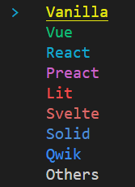
Installing React - vite
React is very easy to install in VSCode just a few short commands and you have an install that runs exactly as you would hope.
The command below allows us to create an app in a folder base:
npx create-vite@latest solution
The first time you run this, you will be asked to install a specific version of vite. You can respond with ‘y’.
You will be presented with a list of framework options.
Use the arrow keys to select React
Notes:
npx is similar to npm, but calls the content from cdn rather than the installed version on npm. Solution is the name of the app you are creating.

Slide 9
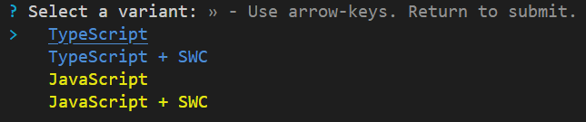
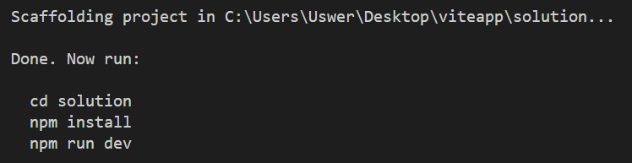
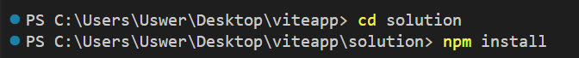
Installing React - vite
Select TypeScript using the arrow keys again to select the variant
With the structure now ready, we need to navigate to our new folder and perform an ‘npm install’.
Once complete, this will allow us to run ‘npm run dev’ to fire up the webpage

Slide 10

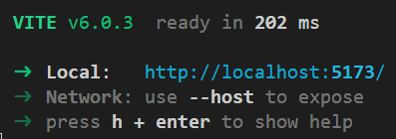
Installing React - vite
This will build a live server which allows us to see how our app looks in a browser
You can click on the link to open the browser

Slide 11
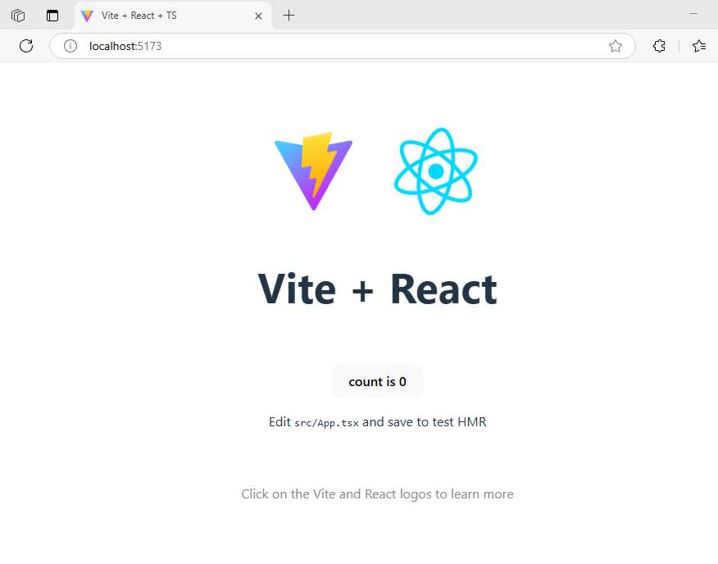
Installing React
Gives you a live locally hosted webpage
You are now ready to explore the framework

Slide 12
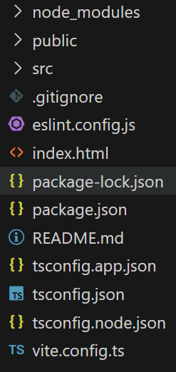
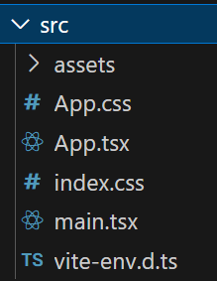
Standard files
At first, the number of files is overwhelming, but we only use a small number of these to any extent.
The files we edit to change our creation are in the src folder so let’s focus there

Slide 13
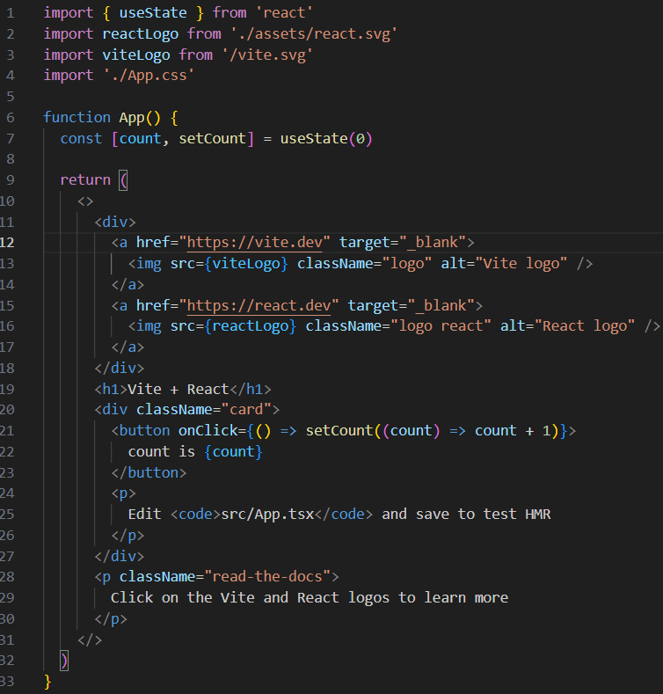
src/App.tsx
This is the file that is passed to the index.html page in the public folder for rendering.
All of the components we create will eventually be passed here to be displayed on screen

Slide 14
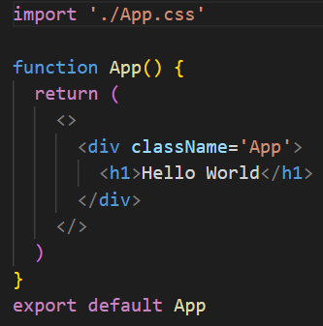
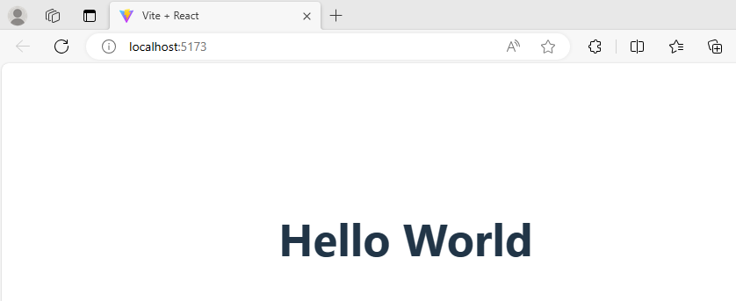
src/App.tsx
Changing the file to this:
Gives us
Notes:
All components feed into the app.ts file – more on components later. But they are very important and build up individual elements of any webpage we create

Slide 15
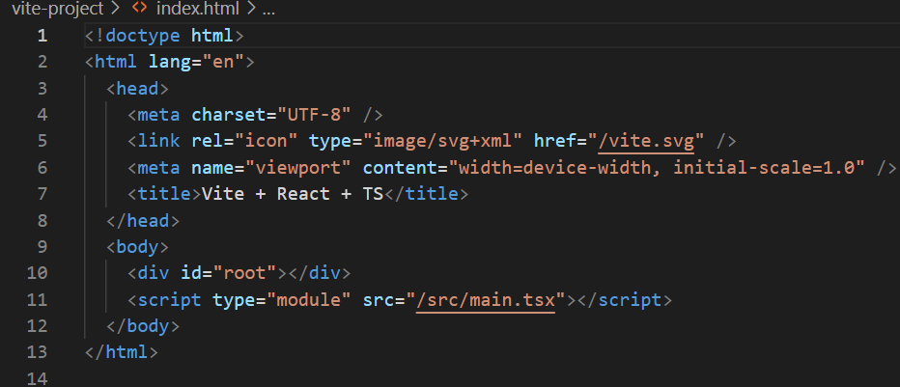
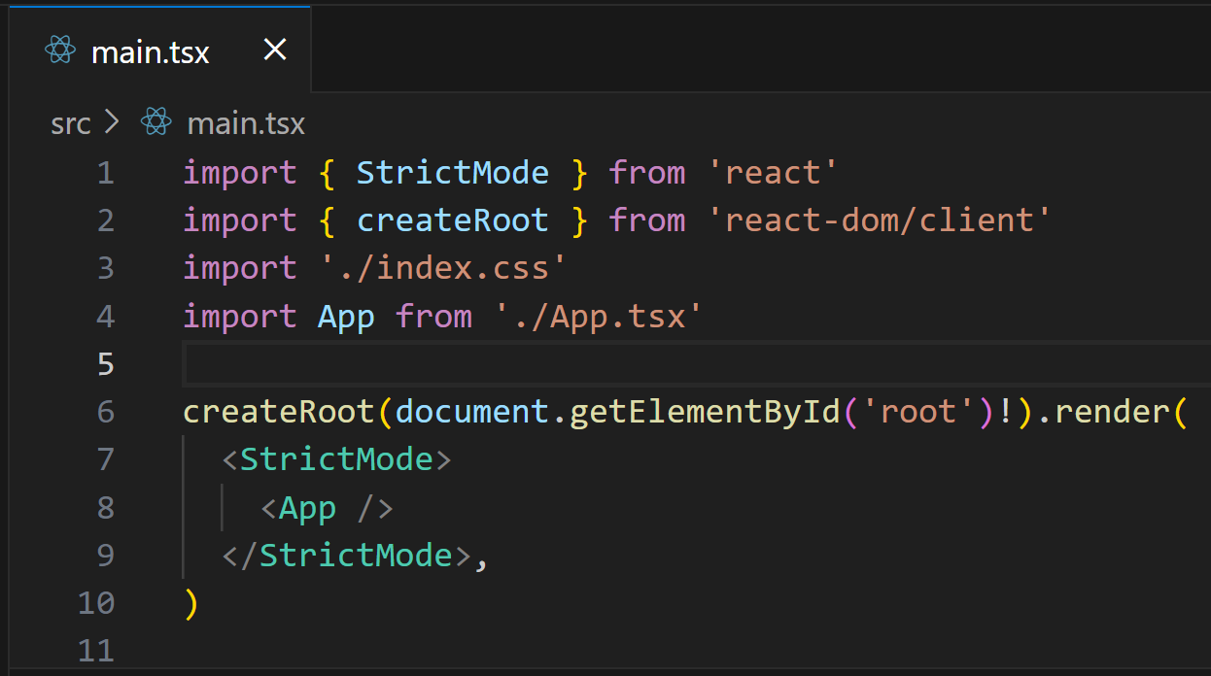
src/main.tsx and index.html
Just like with vanilla JavaScript, you have a webpage which renders the JS in a browser. React is no different .
Notes:
In the html file is a div with an id of “root”. In the ts file is a getElementById constant which finds this and renders the App file into it.
It is a simple as that

Slide 16
Quick Lab 1
Install and edit your first react App

Slide 17
Components in react

Slide 18
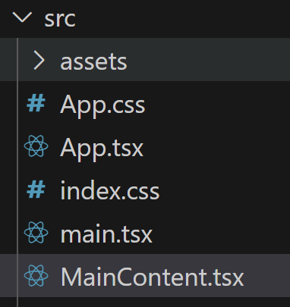
Overview
Components are the building blocks of any react application. They are snippets of code that are called into render when required by the SPAs we create.
Generally, it’s a good idea to split the components up and then call them into App.ts when required.
The easiest way to learn this is to do it.
Start by creating a new file called MainContent.tsx in your src folder

Slide 19
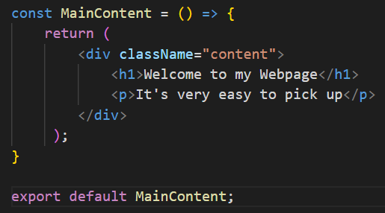
Overview
Inside this we need to create a function that returns some tsx.
This is an arrow function that renders when called. The return is what is passed to the index.html page when all components are rendered to main.tsx
Don’t forget to export at the bottom – just like a JS module
Notes:
tsx is simply a mix of HTML and JavaScript that renders to create content

Slide 20

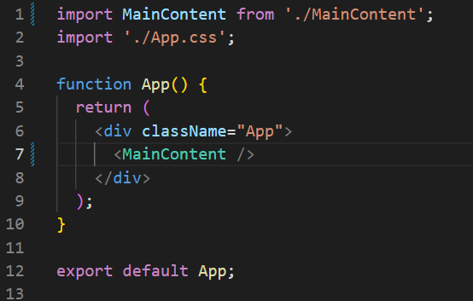
Overview
Inside App.tsx import this module at the top:
Then call the function to be rendered, replacing the <h1> tag
Don’t forget to close the function call!
Notes:
tsx is simply a mix of HTML and JavaScript that renders to create content

Slide 21

Overview
Once you save it, your webpage should re-render to this:
All content in react should be in its own component .tsx file
Notes:
tsx is simply a mix of HTML and JavaScript that renders to create content

Slide 22
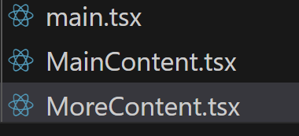
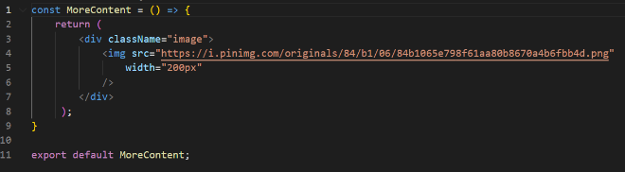
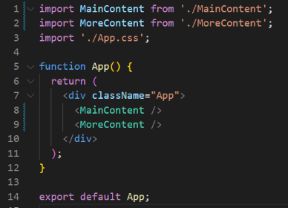
Overview
More Components and more imports build our page
Notes:
tsx is simply a mix of HTML and JavaScript that renders to create content

Slide 23
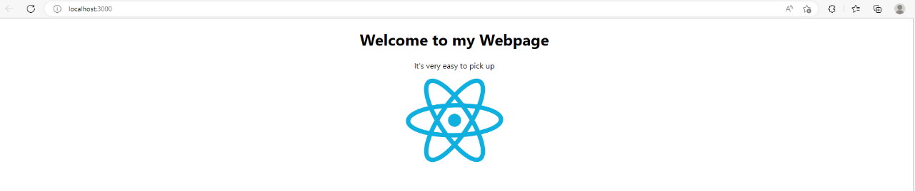
Overview
Notes:
tsx is simply a mix of HTML and JavaScript that renders to create content

Slide 24
Quick Lab 2
Create your first components

Slide 25
Embedding Dynamic content in tsx

Slide 26
Expressions
One of the major benefits of using react and TypeScript is the ability to have variables and content which are dynamic
You will remember that in JS/TS, we can assign a ‘const’ or ‘let’ and then use that value in expressions { } within the code block.
Variables and constants are usually created above the return and then used in the return itself

Slide 27
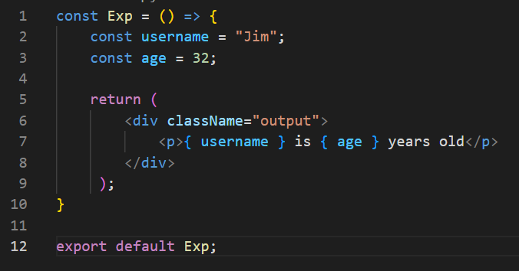
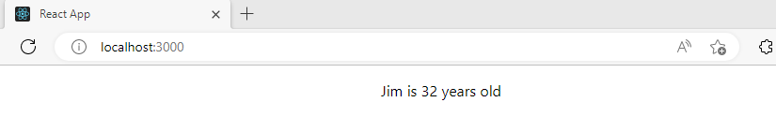
Expressions
This will render the value of the constant above in the return. It also works with numbers

Slide 28
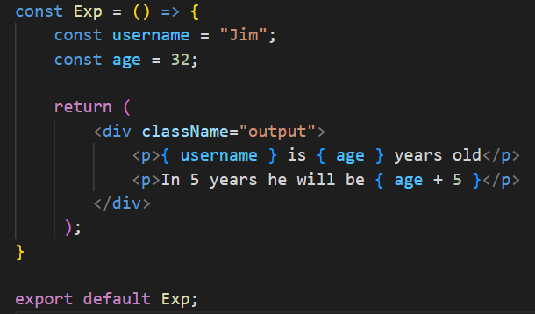
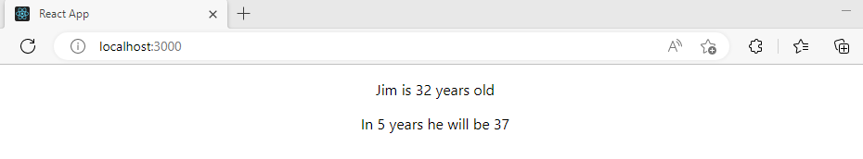
Expressions
Like other Expressions, you can perform calculations within the curly braces.

